Slide 1
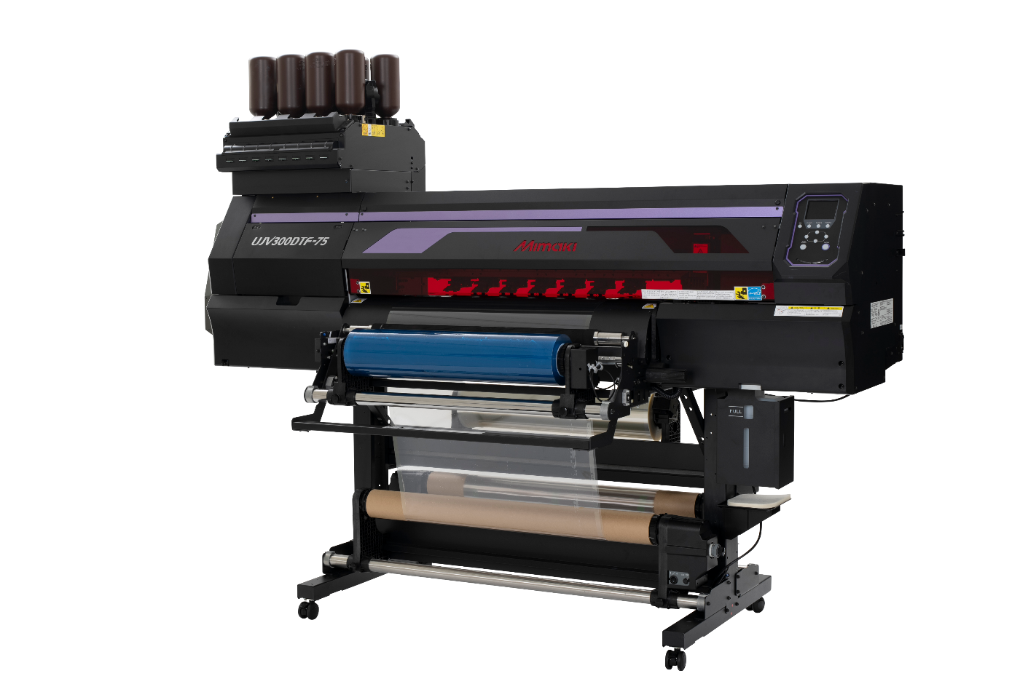
UJV300DTF-75
Sales quick guide
Mimaki USA, Inc.
HGonzalez
8/25/25
v1.0

Slide 2
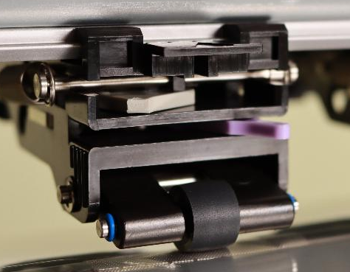
Rollout Status ✅
  Machines are rolling out
  No FCO required
  Only 12 demo units needed roller replacement
  All customer machines ship with final rollers

Slide 3
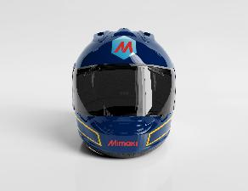
What is UV-DTF?
  UV printing onto film, transferred like a sticker
  3-step workflow: Print → Apply → Peel
  No weeding required, fine detail and edges intact
  Expands print applications to large, curved and complex surfaces

Slide 4
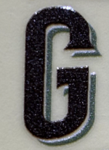
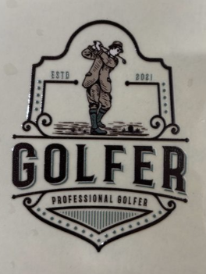
Mimaki Leads in Quality
  Mimaki waveform control = sharp edges & smooth solids
  Variable dot & MAPS4 = reduced banding and graininess
  Superior print quality over competing UV-DTF units

Slide 5
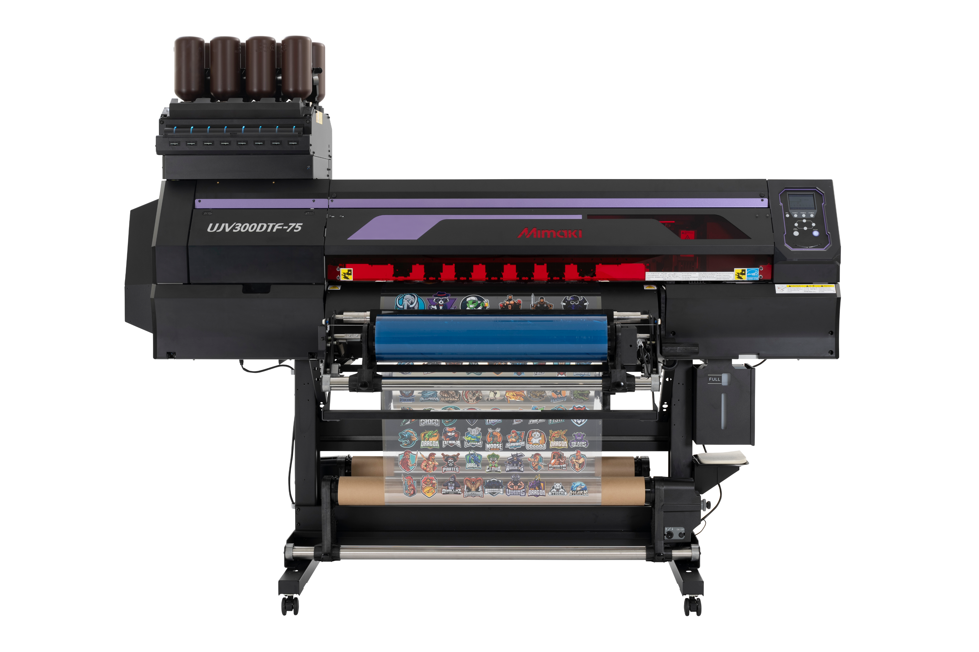
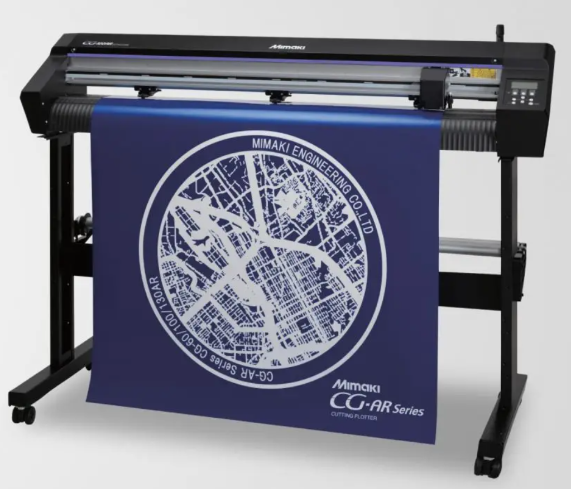
Market Opportunity
Startup and established businesses
  New application opportunities
    Odd or oversized items
  Limited / Short run volume
  Variable data print items
  Same look and feel through product line
    Complimentary equipment to flatbeds & Kebab applications
  Start printing even before your product arrives!
  Easy Print and Cut workflows with CG-AR

Slide 6
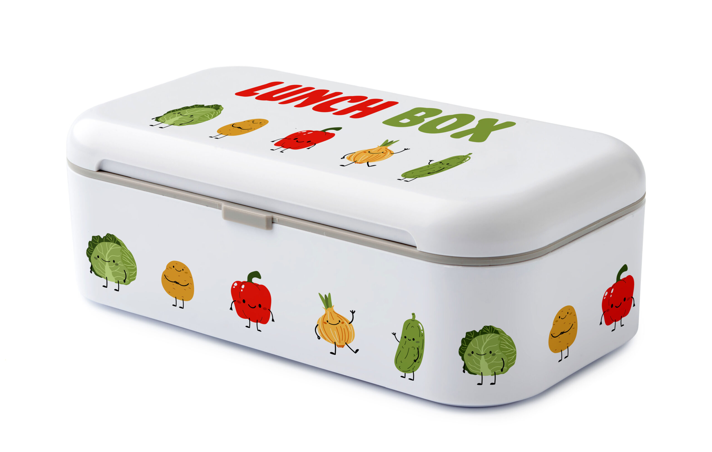

We lead in Ink Safety and Quality
  Scratch resistant
  More than twice outdoor durability than STS
  New UV inks: ELH-100 (hard) + ELS-170 (flexible)
    Strength + flexibility for transfers
  Eco-certifications: GREENGUARD Gold, CMR free, RoHS3, VOC free
  No SVHC concerns vs competitors

Slide 7
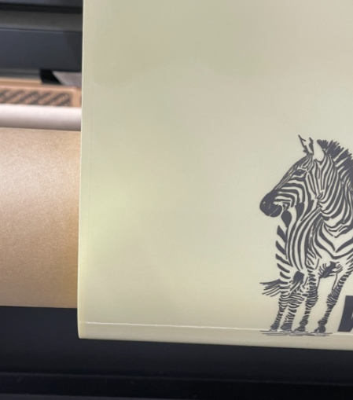
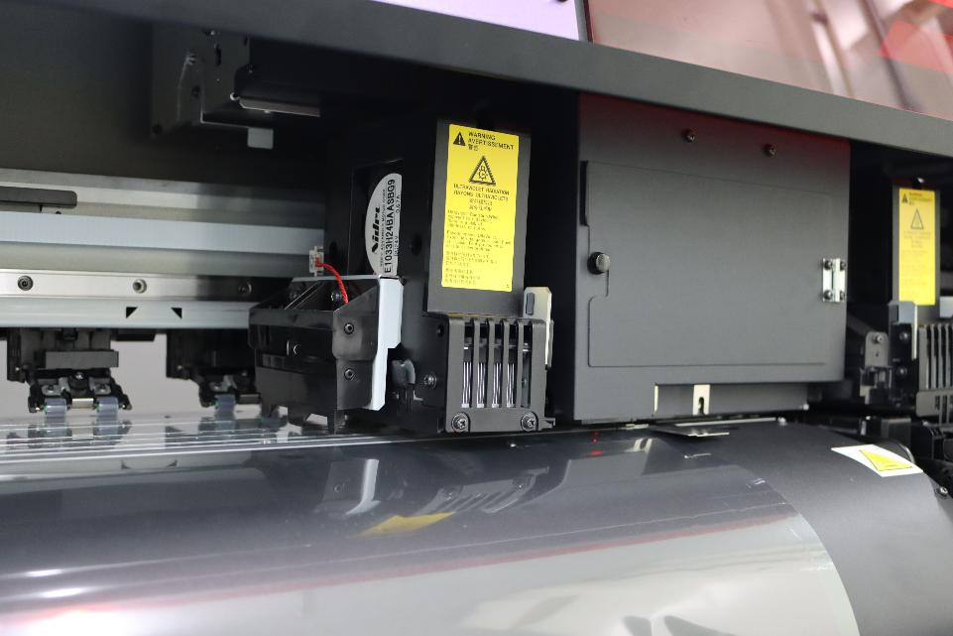
Stabile & Reliable System
High-precision feed with no meandering
  Based on known UCJV300 Series
  Things only we have:
    Proprietary pinch roller system = no meandering
    Automatic nozzle recovery (NCU/NRS)
    White ink circulation (MCT) for consistent results
    Jam sensor for head protection
The sensor reacts and stops printing before the heads collide.

Slide 8
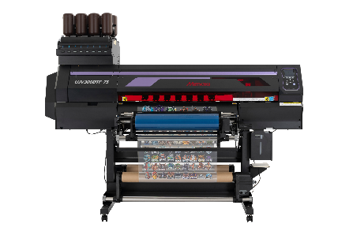




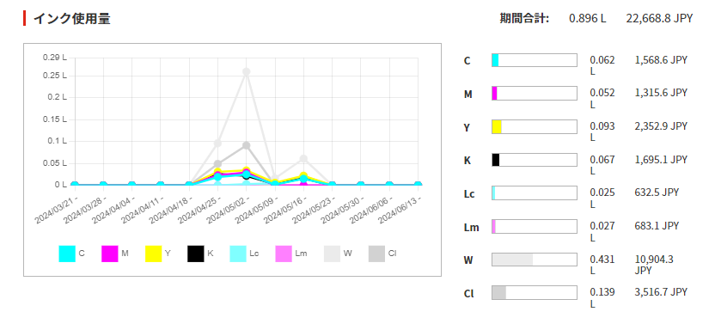


PICT enabled
Free remote monitoring production tool for status, ink usage & service support
Remote monitoring
  Ink Usage and forecast
  Production stats
  Tech support information and more

Slide 9
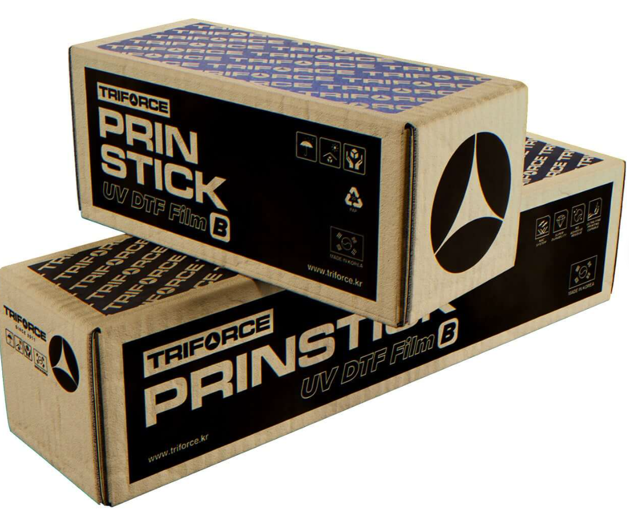
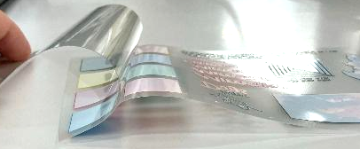
Media for Success
  Triforce (my overall pick) https://triforce.kr/
    excellent adhesion
    dishwasher/microwave safe on ceramics, glass & stainless
    recommend handwashing for plastic applications
  Color Prime (rebrand by Lawson)
    decent overall option
    recommended hand wash
    dishwasher/microwave safe on ceramics
    usable on glass/PP >1" designs
  Testing parameters and general
    Tested across ceramics, glass, stainless, the plastics
    Ceramic: dishwasher & microwave safe
    Glass/stainless: safe except very fine lines
    Plastics: more likely to have problems when hot
  3 other brands currently under evaluation

Slide 10
Key Takeaways
  First Japanese-engineered UV-DTF printer
  Powered by Mimaki Core Technologies
  Market-leading print quality & reliability
  Easy workflow & wide application range
  Among the best ink for this application
  Rollout ready

Slide 11

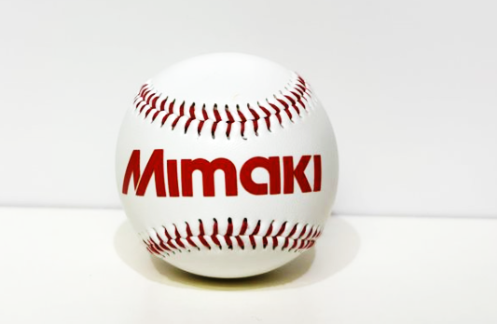
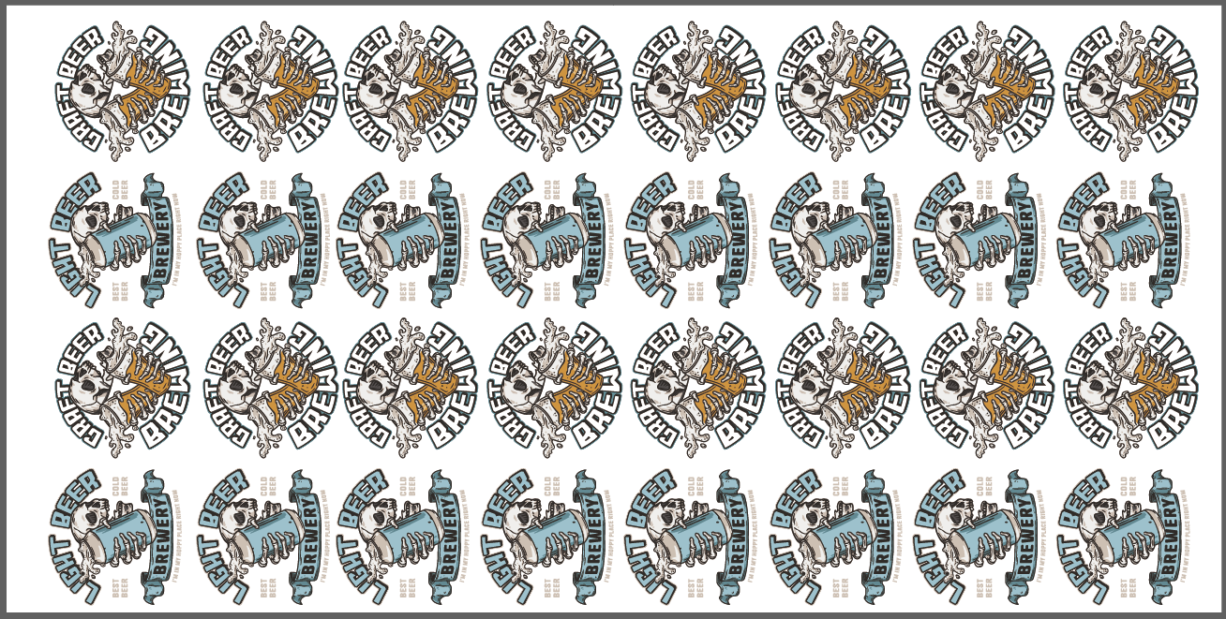



Materials ROI
Materials ROI | Glassware | Baseball | Decal Sheet (24 in x 12 in)
Ink consumption | 0.134 cc / piece | 0.097 cc / piece | 2.000 cc/ sheet
Ink cost $0.26/cc* | $0.035 / piece | $0.025 / piece | $0.52 / sheet
Data
Data size (W x D) | 2 in x 2 in | 3.14 in x .6 in | 24 in x 12 in
Item price each | $3.50 / piece | $4.24 / piece (blanks) | 0 – sell the sheet direct
Total materials cost (ink) (assuming $1.23 linear ft film) | $3.55 / piece | $4.28 / piece | $1.75 / sheet
Selling price each | $16.46 / piece | $15.00 / piece | $18.99
Profit | $12.91 / piece | $10.72 / piece | $ 17.24 / sheet
Printing conditions: UJV300DTF-75 600 x 600 dpi 16Pass 3-layer printing (white → color → clear matte)

Slide 12
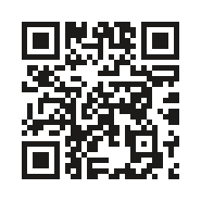
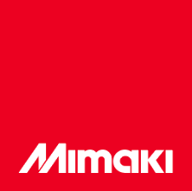
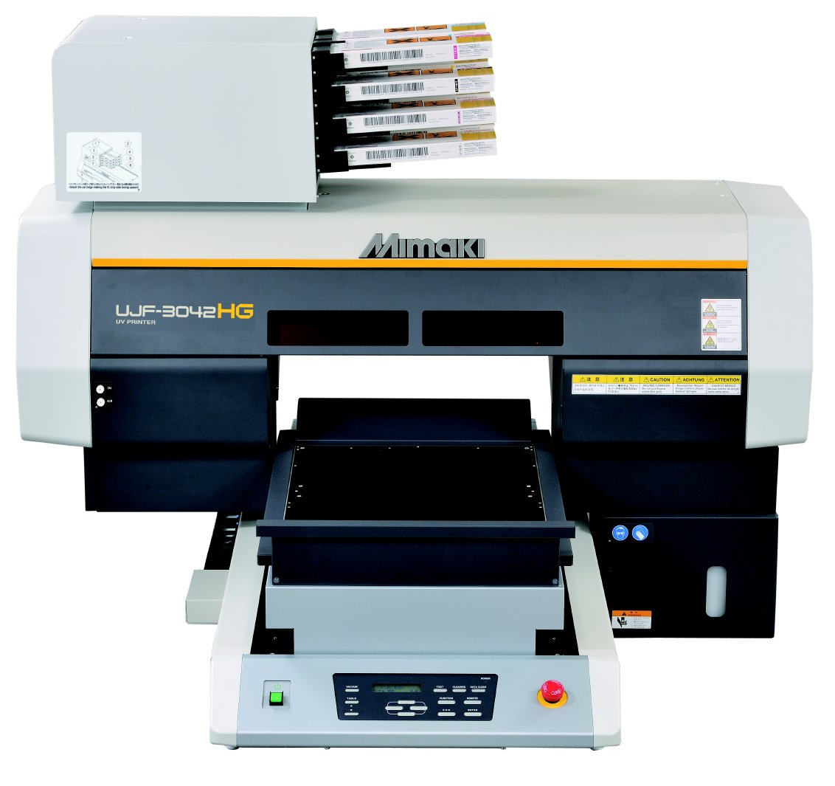
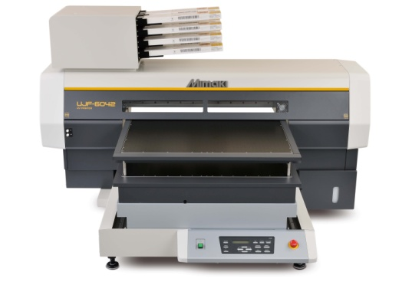
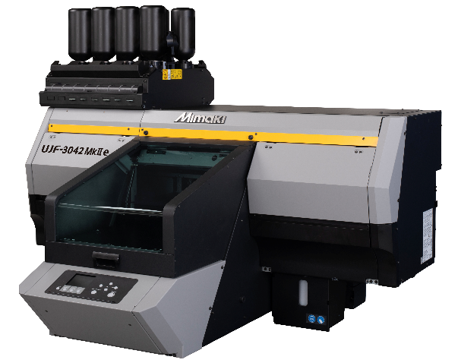
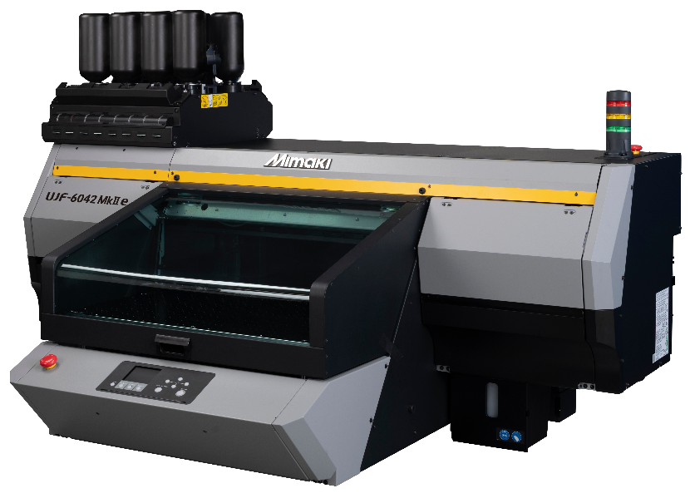
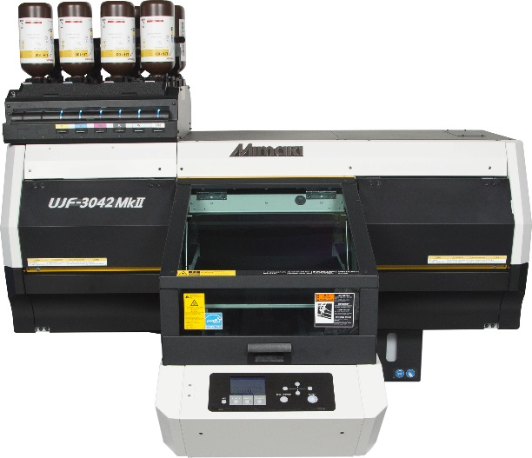
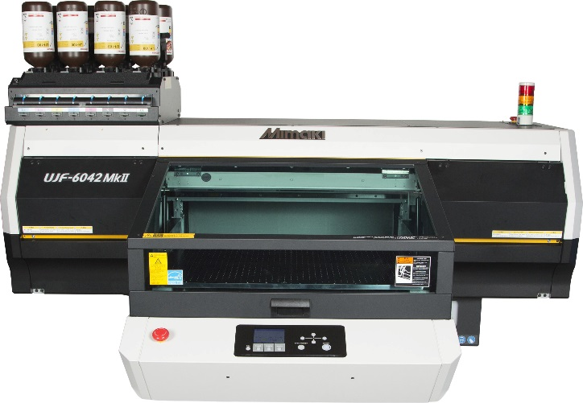

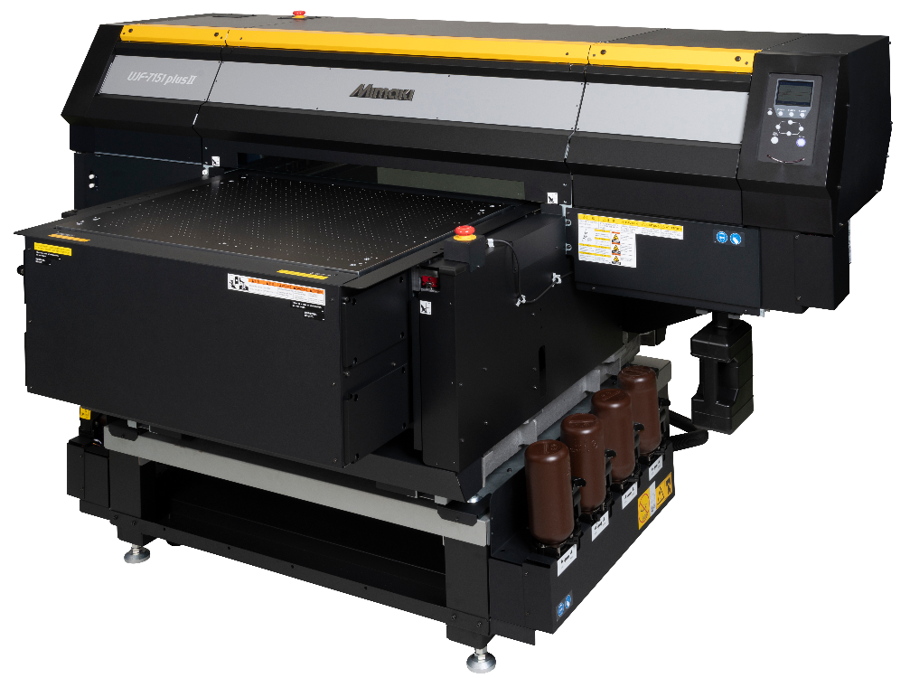
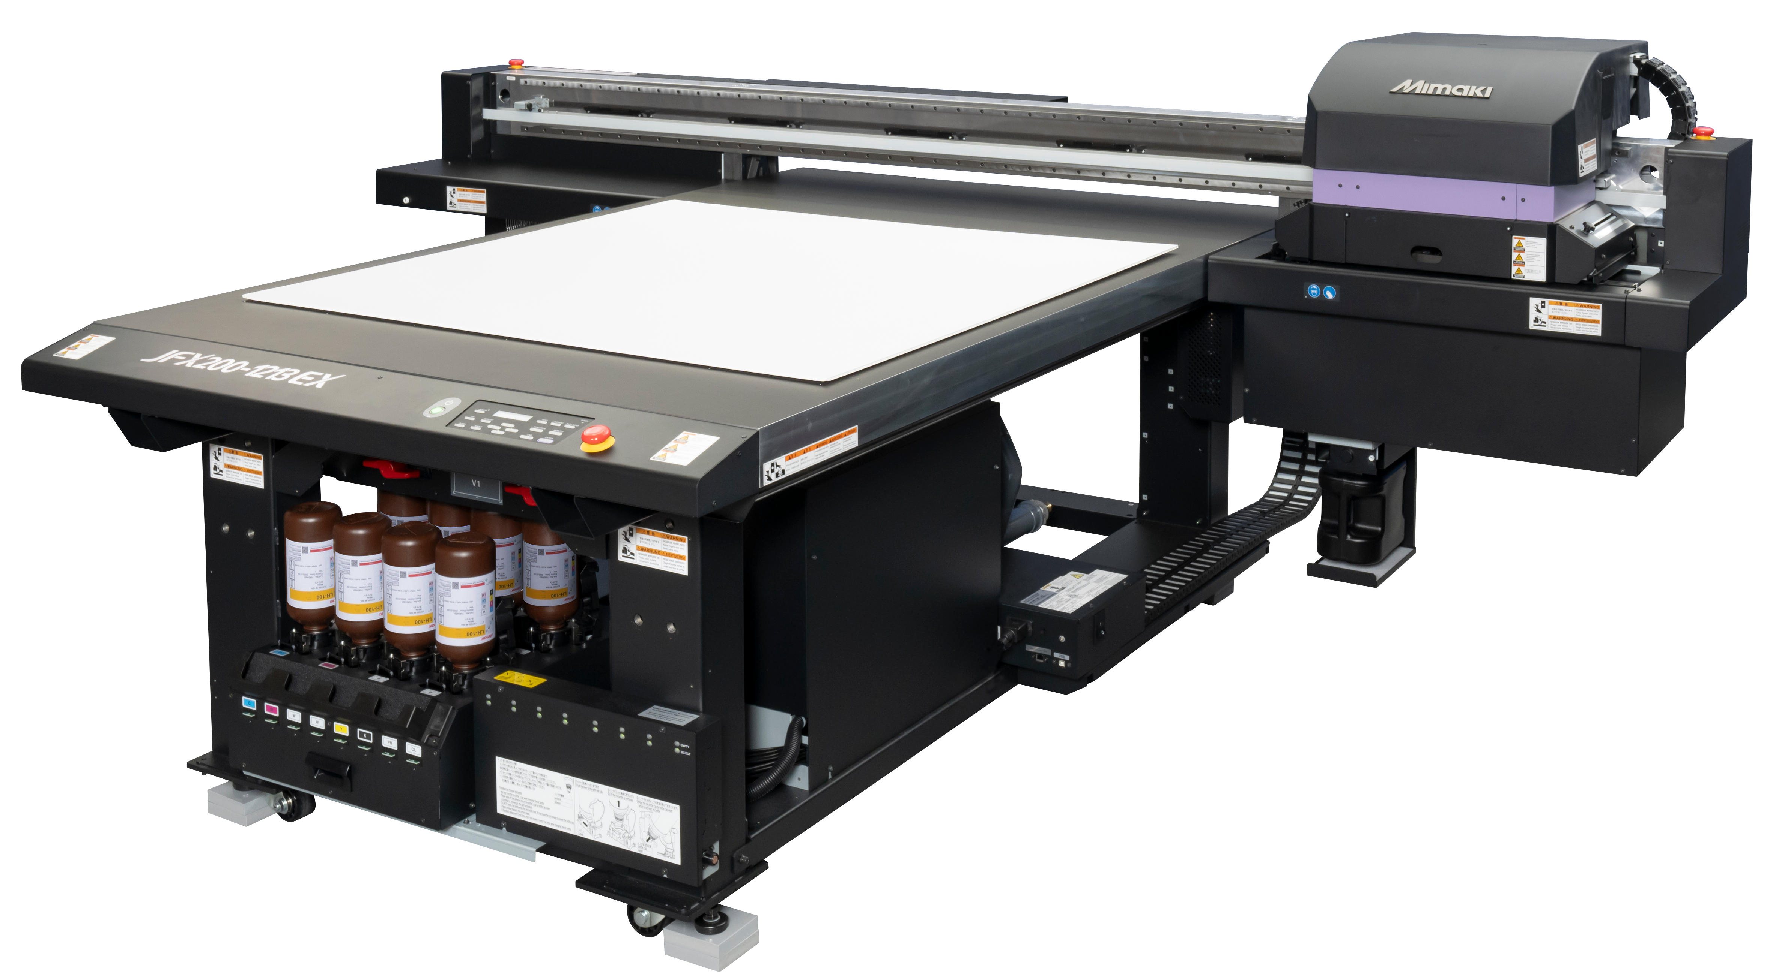

UPGRADE FROM UJF SERIES TO THE NEXT LEVEL
Apply with Elm Blue
SCAN HERE!
Your Current UJF Series
>> Upgrade to The Latest models
https://lp.elmblue.com/mimaki
UJF-3042 MkII e
UJF-6042 MkII e
MSRP
$ 21,995 + tax
$ 446 / mo - 60 mo*
MSRP
$ 40,015 + tax
$ 811 / mo - 60 mo*
Highest productivity in its class.
Long Distance Print mode supports gaps of up to 4.5 mm.
Equipped with an inkjet primer to improve ink adhesion.
ADA-compliant Braille printing.
THE NEXT LEVEL
>> Expand Applications
>> With Higher Precision
>> Boost Productivity
UJV300DTF-75
UJF-7151 PlusII
JFX200-1213 EX
MSRP
$ 29,995 + tax
$ 608 / mo - 60 mo*
MSRP
$ 65,995 + tax
$ 1,338 / mo - 60 mo*
MSRP
$ 71,495 + tax
$ 1,449 / mo - 60 mo*
Up to
34.4 ft²/h
Printing speed
Maximum
25.2 in
Print width
Minimum
7 pl
Droplet
Up to
81.6 ft²/h
Printing speed
Maximum
28 x 20 in
Print area
Minimum
6 pl
Droplet
Up to
269 ft²/h
Printing speed
Maximum
50 x 51.2 in
Print area
Minimum
7 pl
Droplet
Next gen ink – scratch resistant, can apply on curves, SVHC-Free, CMR-Free,
Stable film feeding with the newly developed Pinch Rollers.
Gloss and matte finishes
Mimaki unique core technology for high quality printing & opaque white
Best-in-class precision with 1800 x 1800 dpi.
Enhance your print quality with Unique Color Gloss and 2.5D printing.
Long Distance Print mode supports fine line printing with gaps of up to 4.5 mm.
ADA-compliant high-speed Braille printing.
Prodcution output of 194 ft²/h with simultaneous 2-layer printing.
1200 × 1200 dpi enables practical printing of 3 pt text.
Clear and primer ink expand customer opportunities.
ADA-compliant, high-speed Braille printing.
*Disclaimer: Not all applicants will qualify for financing. All programs and terms are subject to credit review and determined at the time of approval by ElmBlue Capital LLC and its affiliates.
Mimaki USA, Inc. www.mimakiusa.com

Slide 13
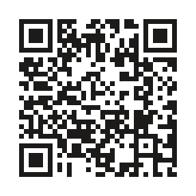
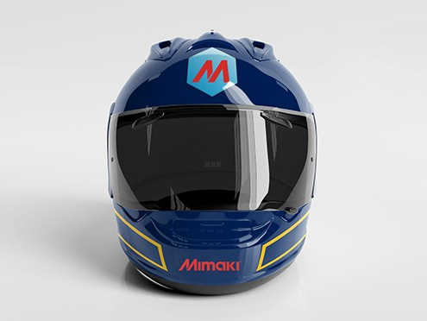
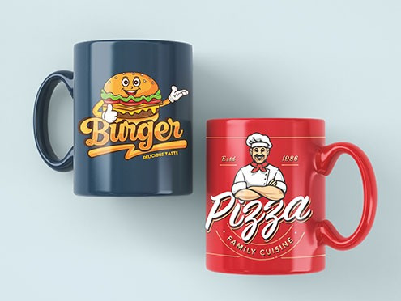



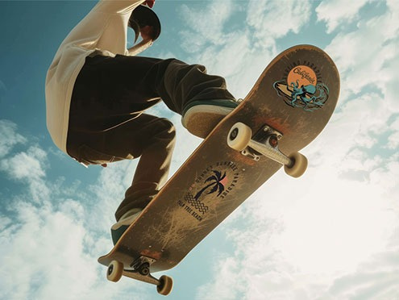



EXPANDING YOUR BUSINESS WITH UV-DTF
For More Info
SCAN HERE!
www.mimakiusa.com
What is UV-DTF?
It is a digital printing technology that uses UV cured ink to create a sticker-like transfer graphics that can be applied to various substrates and curved/small items.
Why UV-DTF?
Versatile Material
Suitable for a wide range of materials, including metals, glass, wood, ceramics, coated surfaces, and PC/ABS. Capable of decorating curved and uneven surfaces.
Simple Workflow
No need for cutting or weeding like stickers. No powder or heater required like DTF. Just print, apply and peel.
Premium Look
With opaque white ink, vivid colors are achieved without being affected by the color of the material. Clear ink allows for gloss or matte finishes to match the material or design.
FAQs
Dishwasher safe?
Generally, hand‑wash is recommended. Dishwasher use may be possible depending on the substrate and the specific A/B film set.
Outdoor use?
Suitable for indoor use and gadget decoration. For outdoor applications, cracking or color shift may appear after ~4–8 months, depending on conditions.
Productivity & Profit
Size
Productivity potential
Blank item cost (ea)
Ink cost
Film cost
Retail Price (ea)
Unit gross margin (per hour)
Mugs
2.5 x 2.5 in
380 pcs/h
$ 2.00
$ 0.04
$ 13.24
$ 10.00
$ 3011.56
Tumblers
3 x 2.75 in
pcs/h
$ 3.00
$ 0.03
$ 0.0
$
$
Stickers
3.9 x 3 in
pcs/h
$ 0.00
$ 0.15
$ 0.
$
$
Printed at 600 x 600 resolution – 22.6 sqft/hr
Mimaki USA, Inc. www.mimakiusa.com

Slide 14
ROI worksheet
Print size
Material cut out (add .25” each dim)
Blank item cost
Ink usage (CMYK)
Ink usage (WCl)
Linear ft printed (11.3 ft/h @ production)
Film cost total | $395 / 2 x 328 ft (Triforce)
Per 1 sqft | $0.60
Production print speed | 22.6 sqft/h
ELH-100 | MSRP $243
ELS-170 | MSRP $149

